Slide 1
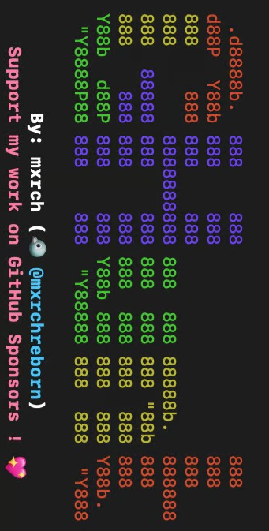
HOW TO INSTALL AND Use ghunt
BY: YAHWEHBOY

Slide 2

What is Ghunt?
Developed by mxrch on GitHub, GHunt is an open-source offensive Google OSINT (Open-Source Intelligence) platform. Security researchers, investigators, and law enforcement utilize it extensively to examine public data and internal APIs connected to Google accounts without taking advantage of security flaws.

Slide 3

How to install GHunt
The Python Way
First you need to install pipx with the command: pip install --user pipx
Pipx allow you to install python packages in isolatedvirtual environments.
Then type: python -m pipx ensurepath

Slide 4
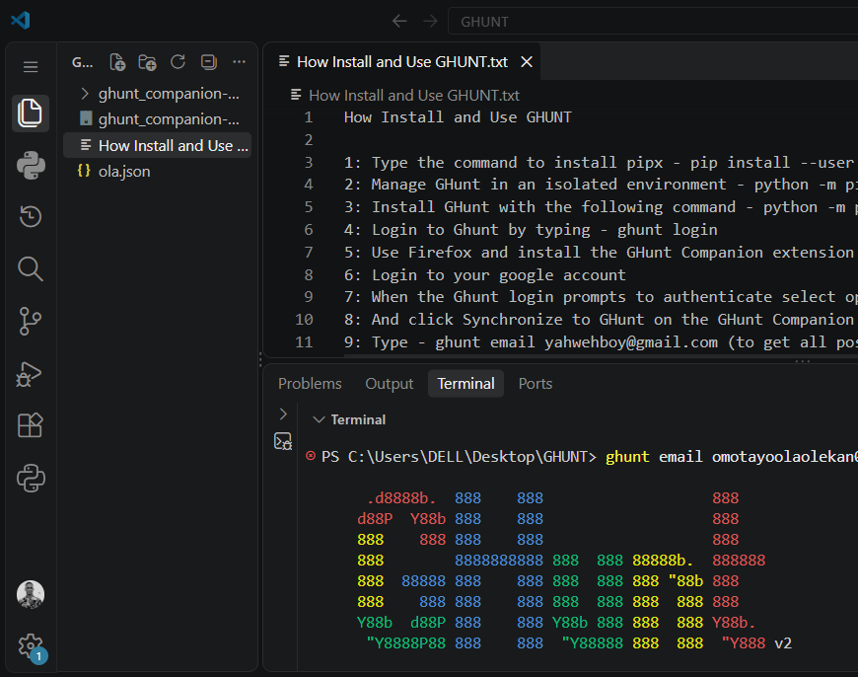
Install ghunt with pipx
Type the command to install ghunt directly from python: python -m pipx install ghunt.
Once the installation is complete type the following command: ghunt and a display like the one below is shown.

Slide 5
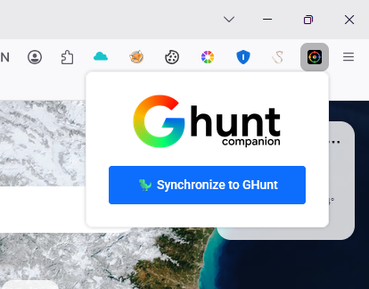
Authenticating Ghunt
Type the command to authenticating ghunt: ghunt login
Download Ghunt Companion extension on Firefox
Login to your Google account
When the ghunt login prompts to authenticate, select option 3 to authenticate
Click "Synchronize to GHunt" on the GHunt Companion extension to automate the token setup; GHunt is now ready to use.

Slide 6
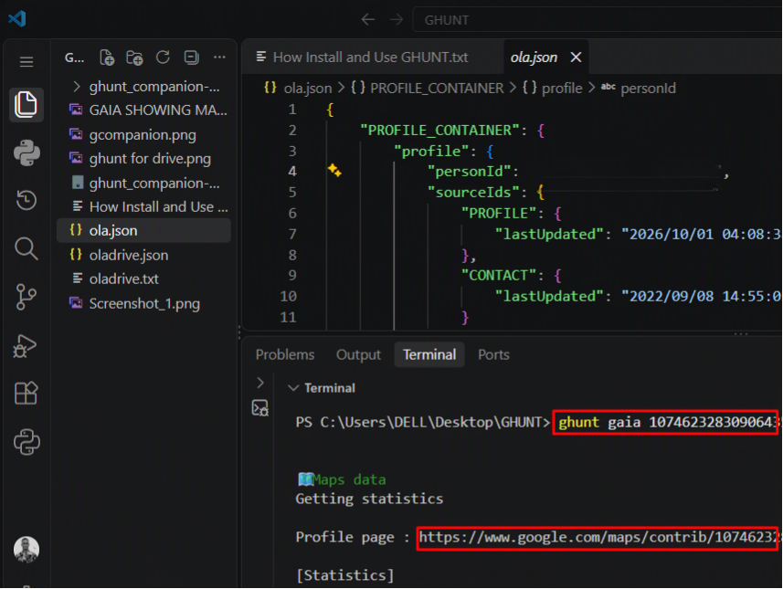

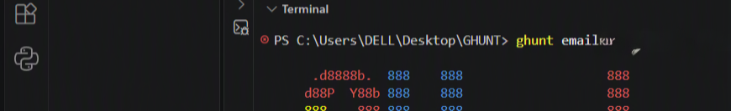
Ghunt for Gmail OSINT
Investigate an email address: ghunt email example@gmail.com (to get all possible information about the Gmail)
Export email results to JSON
ghunt email example@gmail.com --json mine.json (this will generate a json file containing all findings note the personal ID as this can be used in further investigation

Slide 7
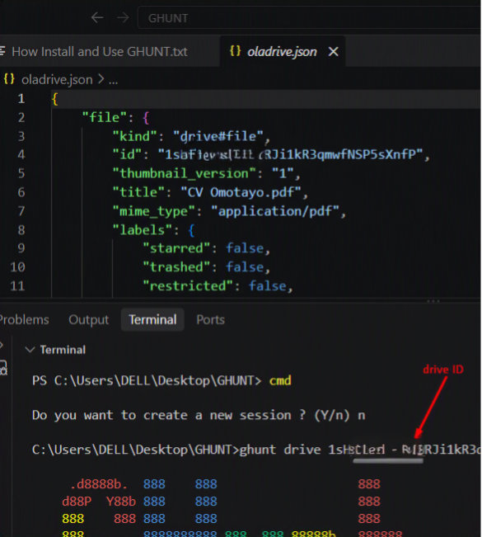
Ghunt for drive file Information Gathering
Investigate a Google Drive ID/file ID: ghunt drive drive_id/file_id (e.g. 1sH_rvohihW1_RJi1kR3) --json oladrive.
This will reveal details of the file, from owner to file permissions. File type. Email associated with the file and shared properties

Slide 8
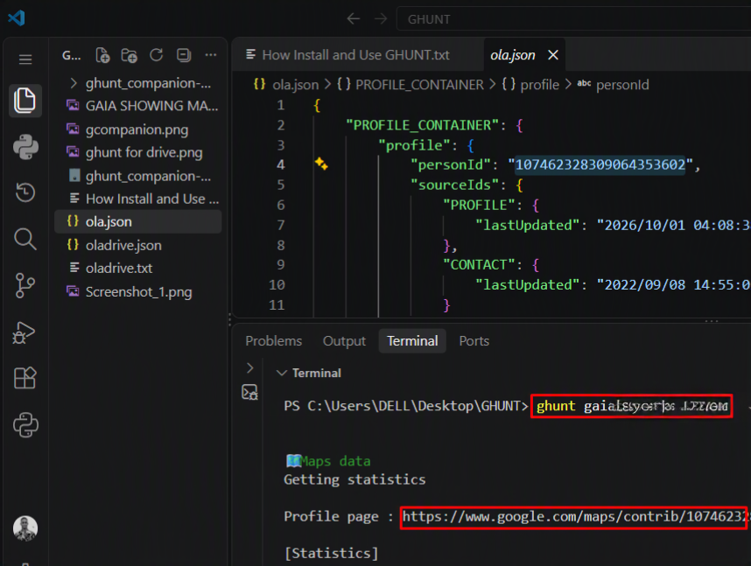
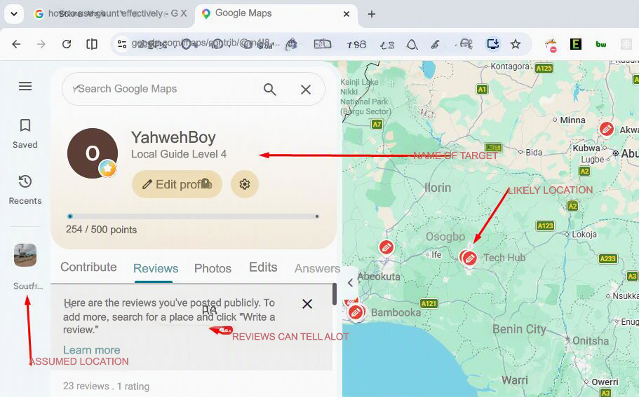
Ghunt gaia for maps activity and location Information Gathering
You can use the following command to find maps activities and likely location of the target: ghunt gaia <personalID> (21-digit personal ID)
This reveals details like map activities and reviews which can be used to track target locations and other sensitive .info
A link is generated copy and paste it in your browser to see the details

Slide 9
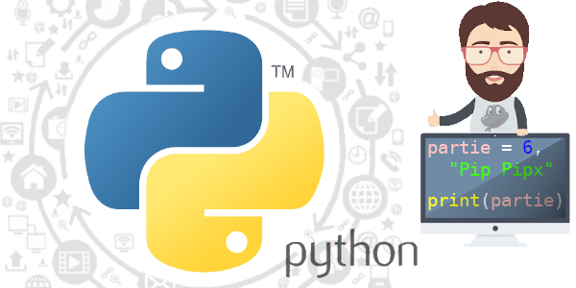
COMMON PROBLEMS & FIXES (IF INSTALLING USING PYTHON / PIPX)
You may run into some errors in the terminal if you install GHunt from Python.
The following are the steps used to fix them:

Slide 10
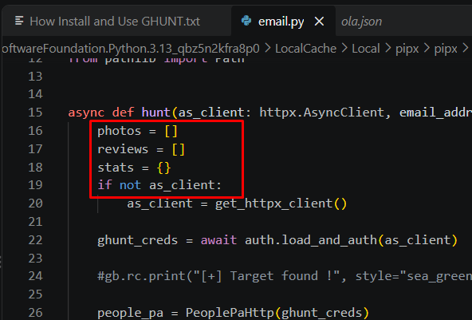
Update email.py
Locate somewhere here, adjust as required for your PC : Path: C:\Users\DELL\AppData\Local\Packages\PythonSoftwareFoundation.Python.3.13_qbz5n2kfra8p0\LocalCache\Local\pipx\pipx\venvs\ghunt\Lib\site-packages\ghunt\modules\email.py
Scroll to the beginning of the async def hunt(...) function block (around lines 20–25).
Add a default fallback value for photos, reviews, and stats right at the start of the function so Python always knows it exists:
  photos = []
reviews = []
stats = {}

Slide 11
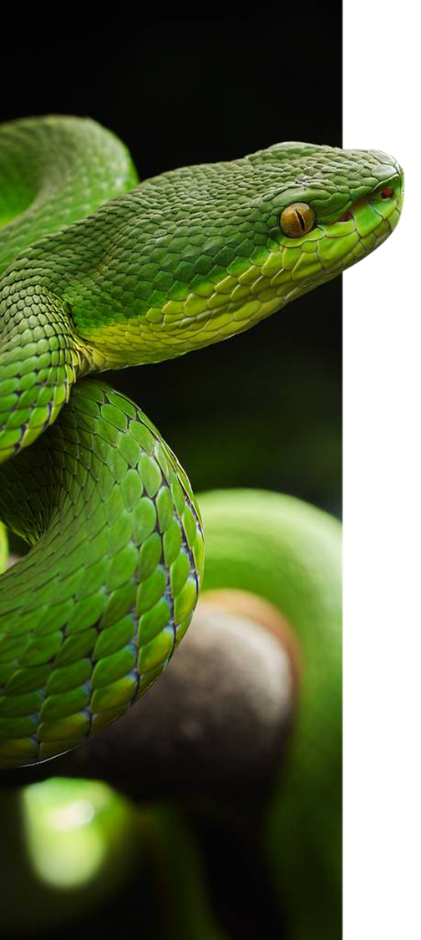
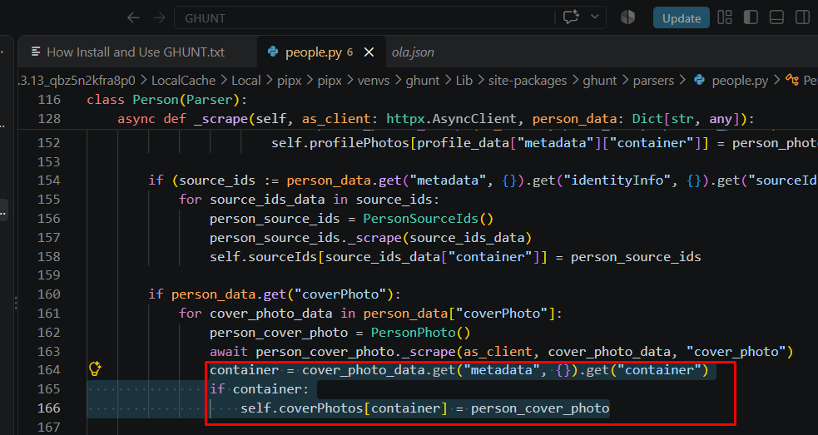
Update PEOPLE.py
Locate somewhere here, adjust as required for your PC : Path: Path: C:\Users\DELL\AppData\Local\Packages\PythonSoftwareFoundation.Python.3.13_qbz5n2kfra8p0\LocalCache\Local\pipx\pipx\venvs\ghunt\Lib\site-packages\ghunt\parsers\people.py
Around line 164 of people.py, errors occurred if the user did not have a profile/cover photo. Here is the fix:
Change that section to:
container = cover_photo_data.get("metadata",{}).get("container")
if container:
self.coverPhotos[container] = person_cover_photo

Slide 12
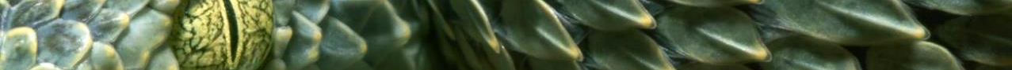
CONCLUSION
If you get errors using python installation method or unable to install ghunt errors, try installing it using the repo on Github: pipx install git+https://github.com/mxrch/GHunt.git.
Use Ghunt only for authorize testing only hacking is illegal.
Informations here are strictly for educational purposes only.

